Slide 1


Anya B. Conrad D. David N. Jordan L. Kayla S. Gabriel S. .

Slide 2



Slide 3

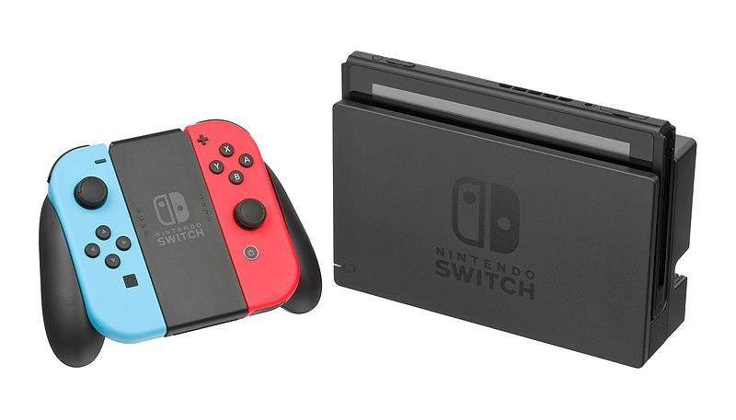

Company Overview
Multinational consumer electronics and video game company
Key products: gaming consoles & video games
Headquartered in Kyoto, Japan
American headquarters in Redmond, WA
5,869 employees [1]
[1] https://www.nintendo.co.jp/corporate/en/outline/index.html

Slide 4
Company Mission & Philosophy
Proud to be the leading company in the gaming industry
Committed to producing and marketing the highest quality products available
Treat every customer with attention, consideration and respect
Listens closely to customers to constantly improve products and services
Maintains an atmosphere in which talented individuals can work together as a team
Treats employees with the same respect that they show to customers
https://www.nintendo.com/corp/mission.jsp
Notes:
Anya’s Slide

Slide 5
Values & Culture
Strives to offer products and services that anyone can enjoy, regardless of age, gender, or gaming experience [1]
Wants to continue being a company that creates entertainment that bring smiles to people’s faces [1]
Likes to assign developers (not senior staff) on small projects to come up with ideas [2]
Super Mario Odyssey, 1-2 Switch came from small groups
[1] https://www.shacknews.com/article/105881/furukawa-talks-nintendo-values-switch-online--the-blue-ocean-in-first-message-to-shareholders
[2] https://www.theguardian.com/games/2018/apr/25/nintendo-interview-secret-innovation-lab-ideas-working
Notes:
Anya’s Slide

Slide 6
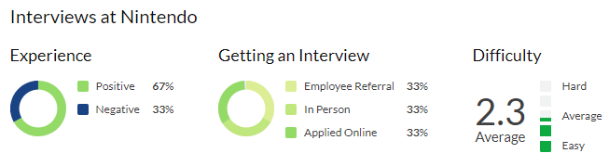
Hiring Process & Interview Loop
Notes:
Kayla’s Slide

Slide 7
Hiring Process & Interview Loop
Apply online at Nintendo / 3rd party source
Email confirming Nintendo’s interest
Phone call with recruiter (proceeded by technical / ethical surveys)
In-Person Interview (panel / one-on-one)
Cultural Interview
Job Offer and Salary Negotiation
[1]https://www.glassdoor.com/Interview/Nintendo-of-America-Interview-Questions-E4173.htm
[2] https://www.glassdoor.com/Interview/Nintendo-of-America-Engineering-Interview-Questions-EI_IE4173.0,19_KO20,31.htm#InterviewReview_191674
Notes:
Kayla’s Slide

Slide 8
Hiring Process & Interview Loop
Want to work at Nintendo?
Expect 4-5 hours for onsite engineering interviews.
Multiple interviews / surveys
Many interviews have in-person technical skill testing
Testing is considered difficult with a heavy focus on position related skills
Applying through a recruiter can help with salary negotiations
[1]
https://www.glassdoor.com/Interview/Nintendo-Seattle-Interview-Questions-EI_IE3533.0,8_IL.9,16_IM781.htm
Notes:
Jordan’s Slide

Slide 9
Hiring Process & Interview Loop
Critical Analysis
Bilingual preferred (Japanese)
Ask questions about cultural differences working for Japanese company
Cultural interviews
C++ heavily preferred
Like to ask questions about favorite Nintendo game(s) and why
Offer performance bonuses up to 20% semi-annually
Looks for developers who aren’t just passionate gamers
[1]https://www.glassdoor.com/Interview/Nintendo-of-America-Engineering-Interview-Questions-EI_IE4173.0,19_KO20,31.htm#InterviewReview_191674
[2] https://www.businessinsider.com/shigeru-miyamoto-hire-gamers-nintendo-2017-12
Notes:
Jordan’s Slide

Slide 10
Hiring Process & Interview Loop
Critical Analysis (PROs)
PROs of Nintendo’s Hiring Process
Ensures that new hires are well versed in the Nintendo culture
Guarantees that people are experts in their fields
Looks for people that are excited to be a part of Nintendo
Interview questions are real world scenarios
[1]https://www.glassdoor.com/Interview/Nintendo-of-America-Software-Developer-Interview-Questions-EI_IE4173.0,19_KO20,38.htm#InterviewReview_4629672

Slide 11
Hiring Process & Interview Loop
Critical Analysis (CONs)
CONs of Nintendo’s Hiring Process
Can take a long time (2+ months) from start to finish
Jobs can be filled by someone else while you are still in the interview process
Often times if you don’t get the job you don’t hear back from Nintendo
Salary range can be a bit on the low side
Not a lot of opportunities for advancement
[1] https://www.glassdoor.com/Reviews/Employee-Review-Nintendo-of-America-RVW19658565.htm
[2] https://www.glassdoor.com/Interview/Nintendo-of-America-Engineering-Interview-Questions-EI_IE4173.0,19_KO20,31.htm#InterviewReview_191674

Slide 12
Hiring Process & Interview Loop
Critical Analysis (Effectiveness)
Effectiveness of Nintendo’s Hiring Process
3.00% turn over rate
Reports of 8+ week interview process
65% of people interviewed recommend applying to Nintendo
67% of people found the process to be a positive experience
[1] https://www.nintendo.co.jp/csr/en/report2018/employees/index.html
Notes:
Standard is near 13% in the industry

Slide 13
Hiring Process & Interview Loop
Critical Analysis (Bias)
Bias of Nintendo’s Hiring Process
73.9% male employees
26.1% female employees
2.13% employees with disabilities (Legal Requirement 2.0%)
Managerial and HR positions 4:1 ratio (male:female)
[1]https://www.nintendo.co.jp/csr/en/report2018/employees/index.html

Slide 14
Working at Nintendo
Salaries, Perks, Hours
Software Engineer: $95,708/yr ($16,000 Bonus)
Sr Software Engineer: $122,136/yr ($29,000 Bonus)
Health Insurance, 401k plan, Maternity & Paternity Leave
Flexible hours (40 per week, remote or office)
3+ weeks vacation per year
[1]https://www.glassdoor.com/Overview/Working-at-Nintendo-of-America-EI_IE4173.11,30.htm
[2]https://careers.nintendo.com/benefits-and-perks/

Slide 15


Working at Nintendo
Additional Perks & Office Space
Food Court, Soccer Field, Tennis Court, In-House Gym
Hawaii Vacation House via Lottery
Tuition Reimbursement
Charity Gift Matching

